Slide 1
Aggregating neighborhood space heating demand
Ina De Jaeger
Bram van der Heijde
Annelies Vandermeulen

Slide 2
Problem statement
District energy system simulations
Trade-off between complexity and accuracy
Can we reduce amount of simulations needed to characterize heat demand of a district?
Represent the behavior of an entire district with a few typical buildings?
n Terraced
SFH
l Detached
SFH
n Terraced
SFH
l Detached
SFH
n Terraced
SFH
1 typical
Terraced
SFH
l Detached
SFH
1 typical
Detached
SFH
m Semi-detached
SFH
1 typical
Semi-detached
SFH
m Semi-detached
SFH
m Semi-detached
SFH
?

Slide 3
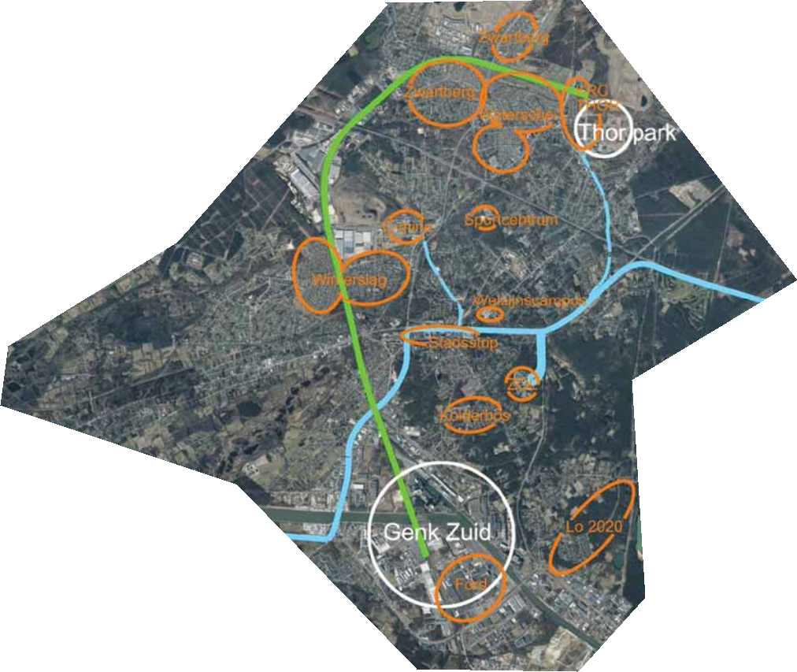
Case
City of Genk, Belgium
Two neighborhoods:
Oud Waterschei (assuming 2000s)
Zwartberg (North-East part, assuming 1950s)
847 buildings in total
3 archetypes per neighborhood
Detached, semi-detached, terraced

Slide 4
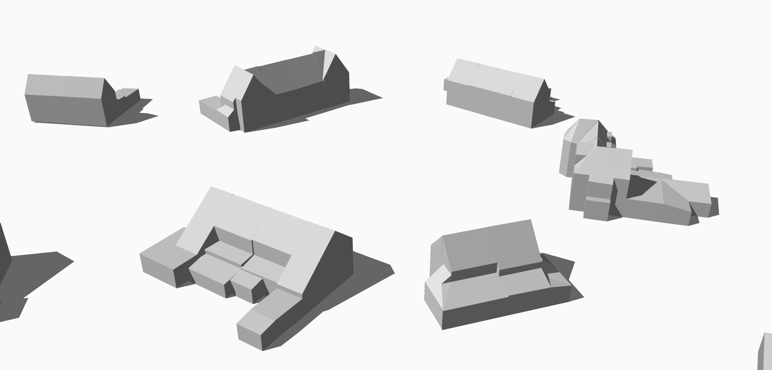


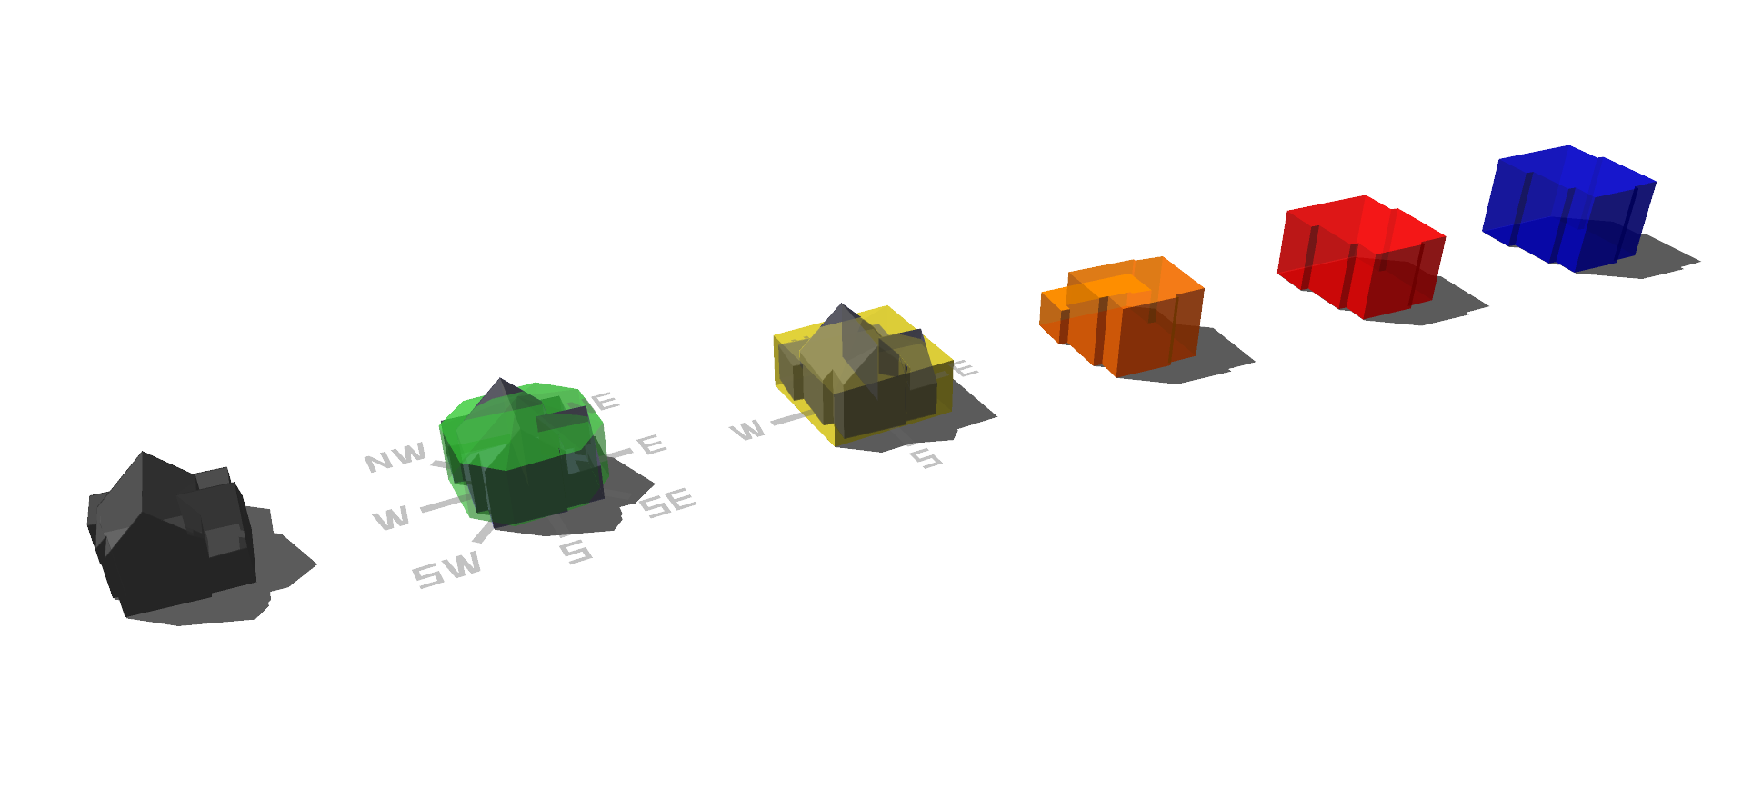



Building model - full simulation?
Geometrical data
Stochastic user behavior (StROBe)
OR standard user behavior
Statistical data for
building envelope
(Belgium)
LOD2
CityGML
(Export)
(Import)
IBPSA - RC
(Export)
IDEAS
LOD2 – merged towards 8 orientations
[RWTH Aachen]
One-zone model
Ideal heating system
(TSet based on air temperature)
Data
Tools
Notes:
In a next step, I investigated the impact of the window sizes on the district energy demand. As you could see, these aren’t included in the CityGML models and thus need to be estimated.

Slide 5
Scenarios?
Building model
Detailed model (IDEAS)
Reduced-order model (IBPSA)
Occupant behavior
ISO 13790: fixed values and time schedule
StROBe: stochastic behavior for every building
assessing the error of averaging the building geometry
different ways of determining the average set-point temperature profile

Slide 6
Building model - archetype simulation?
3 archetypes per neighborhood > 6 archetypes
Geometrical parameters = average of buildings
Thermal performance parameters = identical per neighborhood
Notes:
In a next step, I investigated the impact of the window sizes on the district energy demand. As you could see, these aren’t included in the CityGML models and thus need to be estimated.

Slide 7

Optimization of ROM
modesto
Tool to build DES optimization problems
Energy and mass flows in time
Choose design parameters
Written in python
Pyomo to construct OCP
Gurobi/CPLEX to solve
Calculate minimum temperature profiles

Slide 8
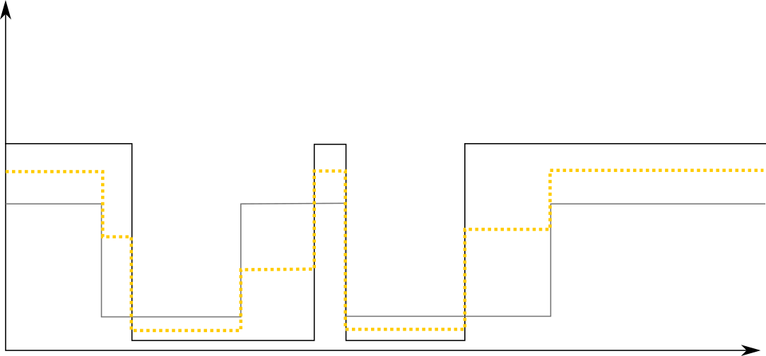
About temperature set-points
Imagine: two buildings with black and grey set-point

Slide 9
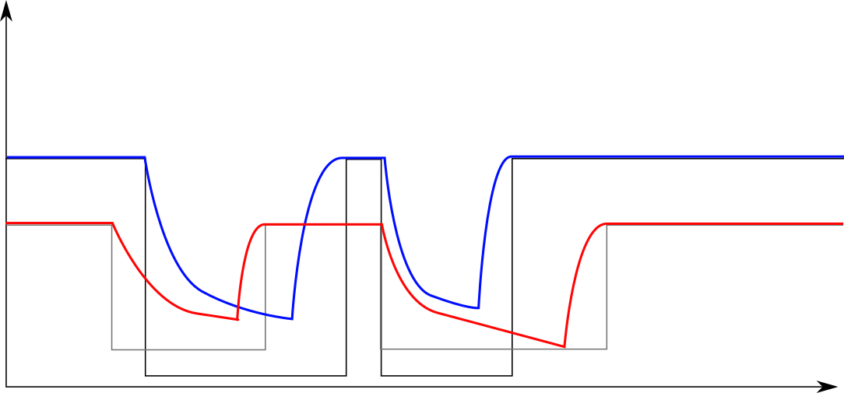
About temperature set-points
Actual temperatures in buildings

Slide 10
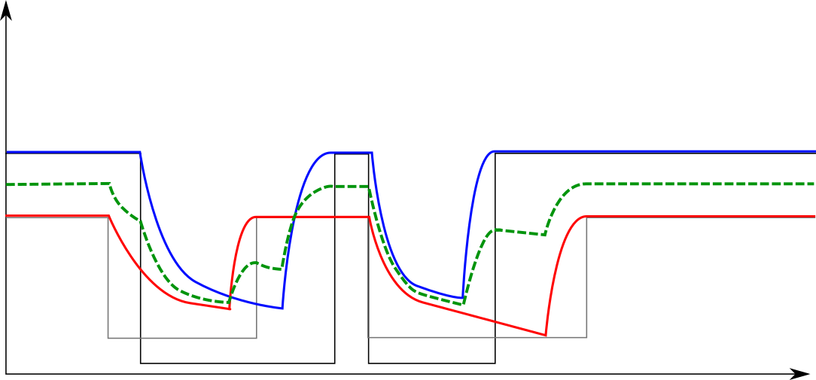
About temperature set-points
Leading to effective set-point profile for the average building
Result: set-point profile with a higher average temperature

Slide 11
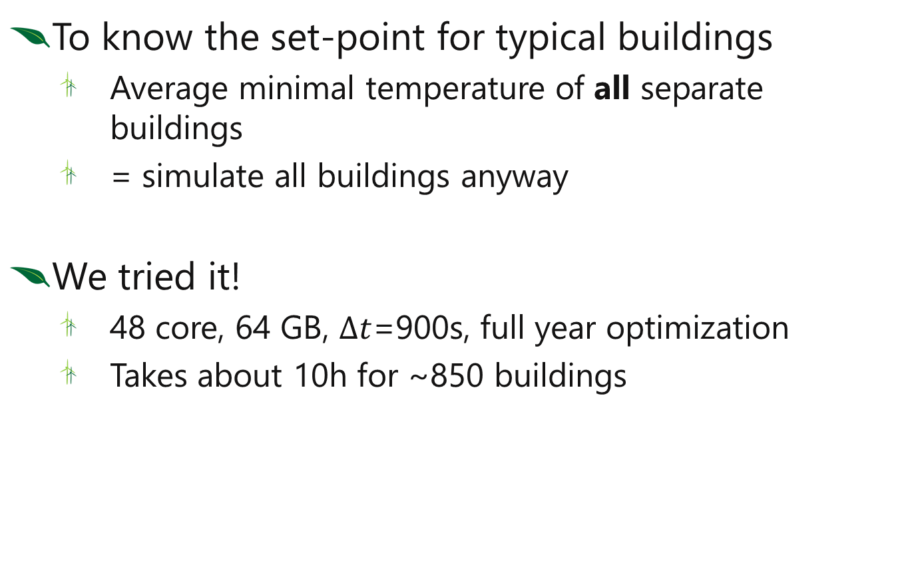
This is going to take a while…
To know the set-point for typical buildings
Average minimal temperature of all separate buildings
= simulate all buildings anyway
We tried it!
48 core, 64 GB, $∆t$=900s, full year optimization
Takes about 10h for ~850 buildings

Slide 12
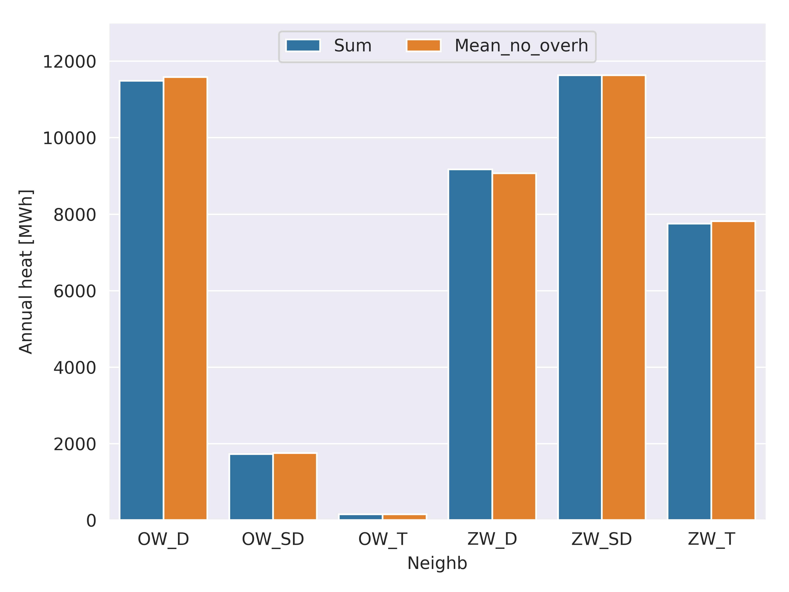
Separate buildings vs. average building annual energy use

Slide 13
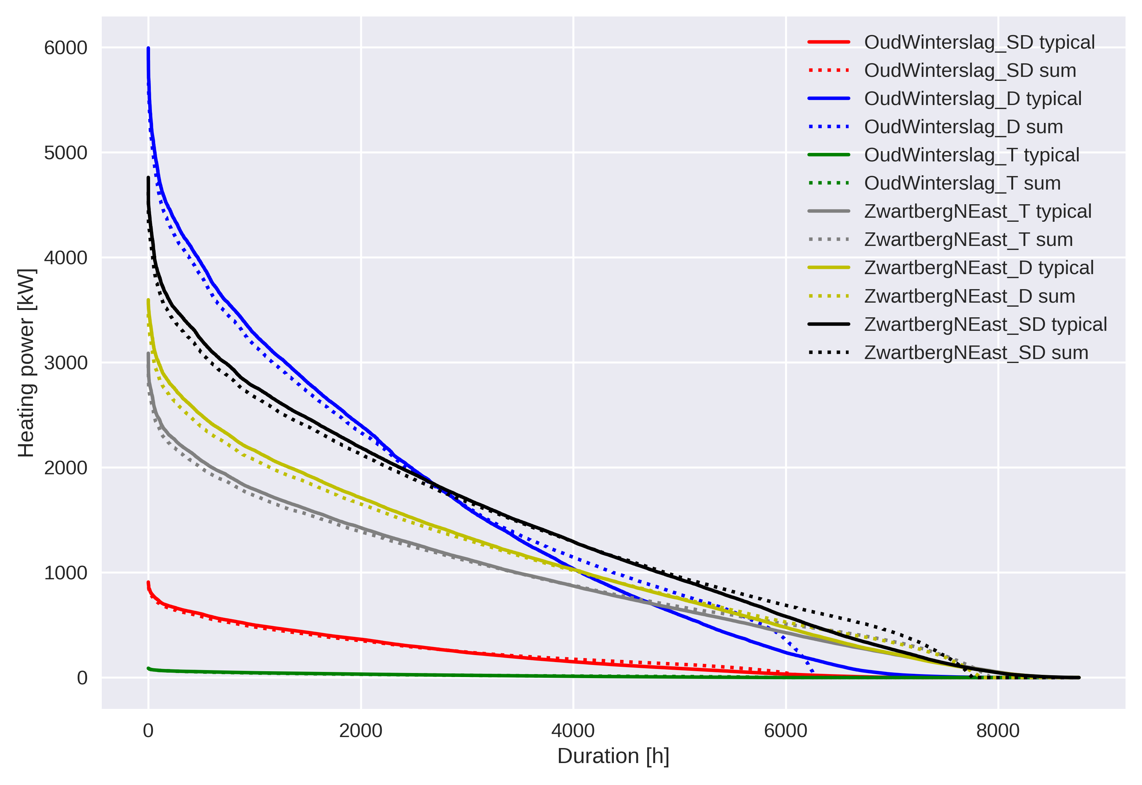


Separate buildings vs. average building load duration curve
The rounded shape is typical for single building simulations.
It gets flattened through large number of buildings.

Slide 14
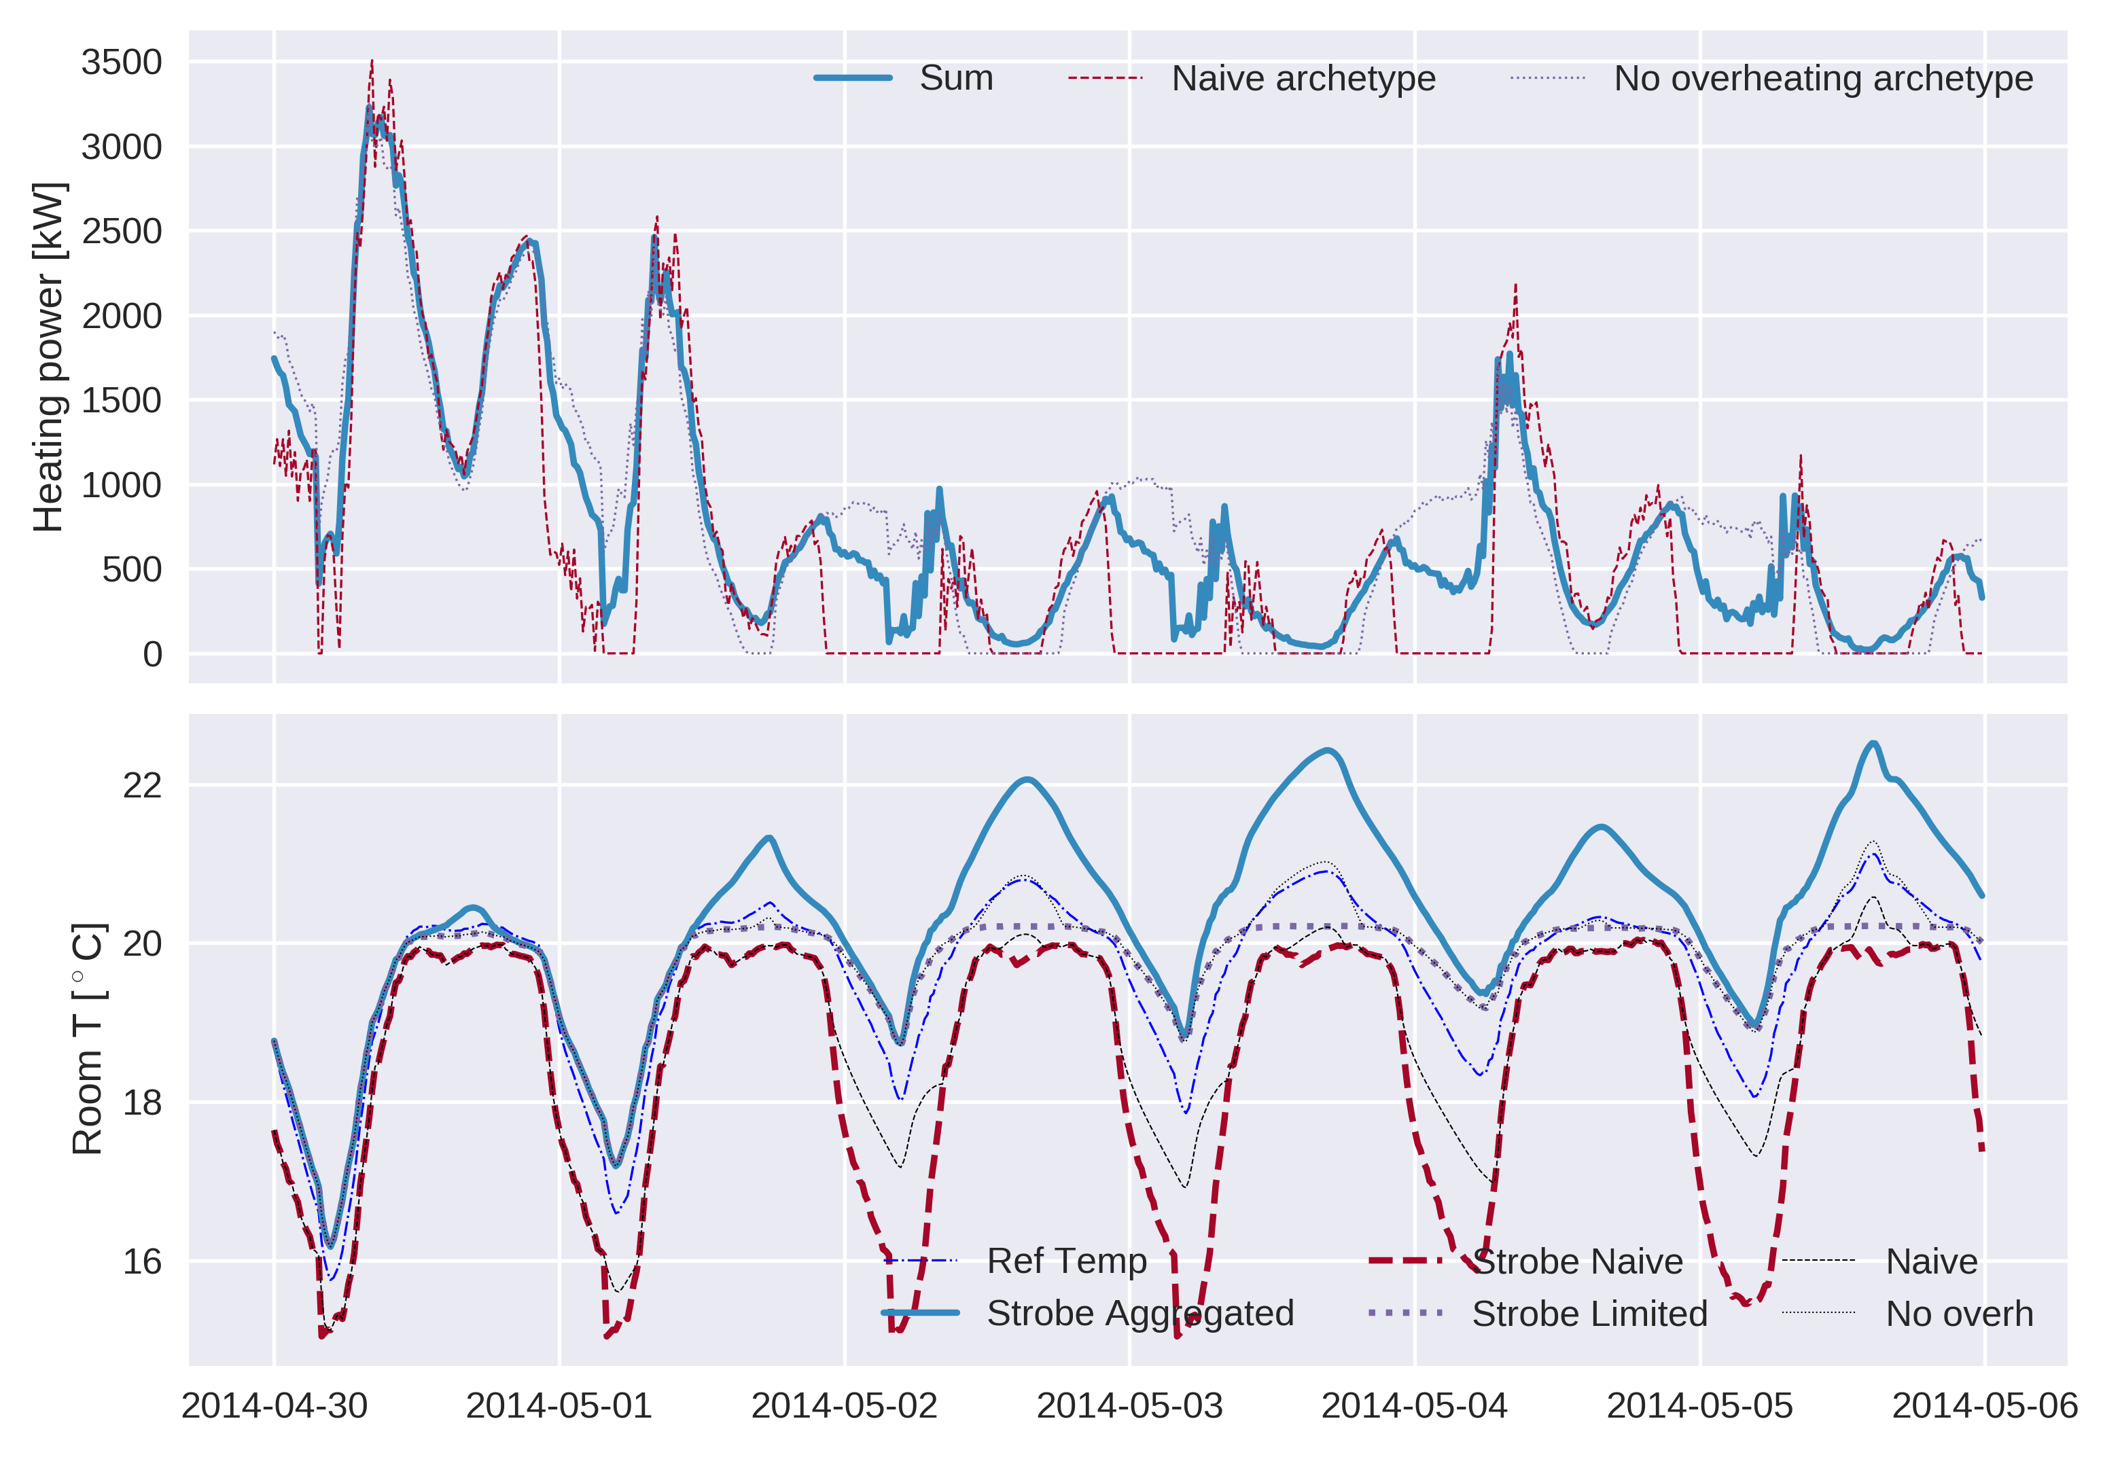
What’s going on?

Slide 15

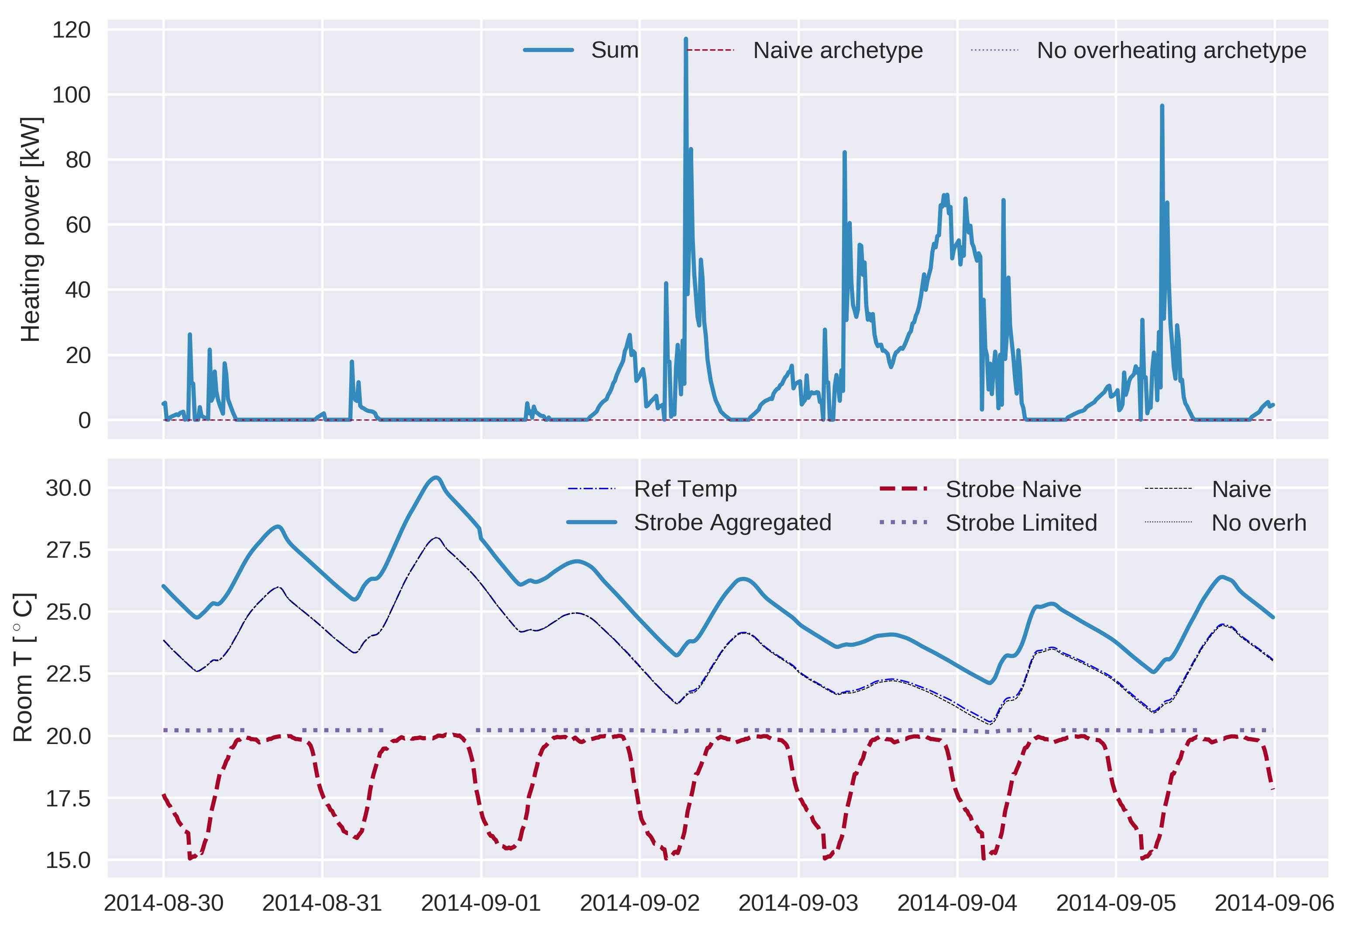
What’s going on?

Slide 16
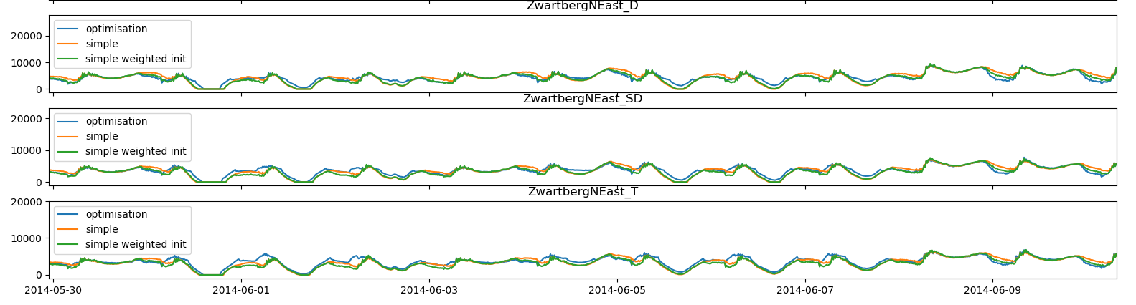
How to reduce complexity?
Use simpler cooling model on downward step in temperature set-point profile
Much faster, but lose some accuracy

Slide 17
Results of simpler method
Speed-up > 10x

Slide 18
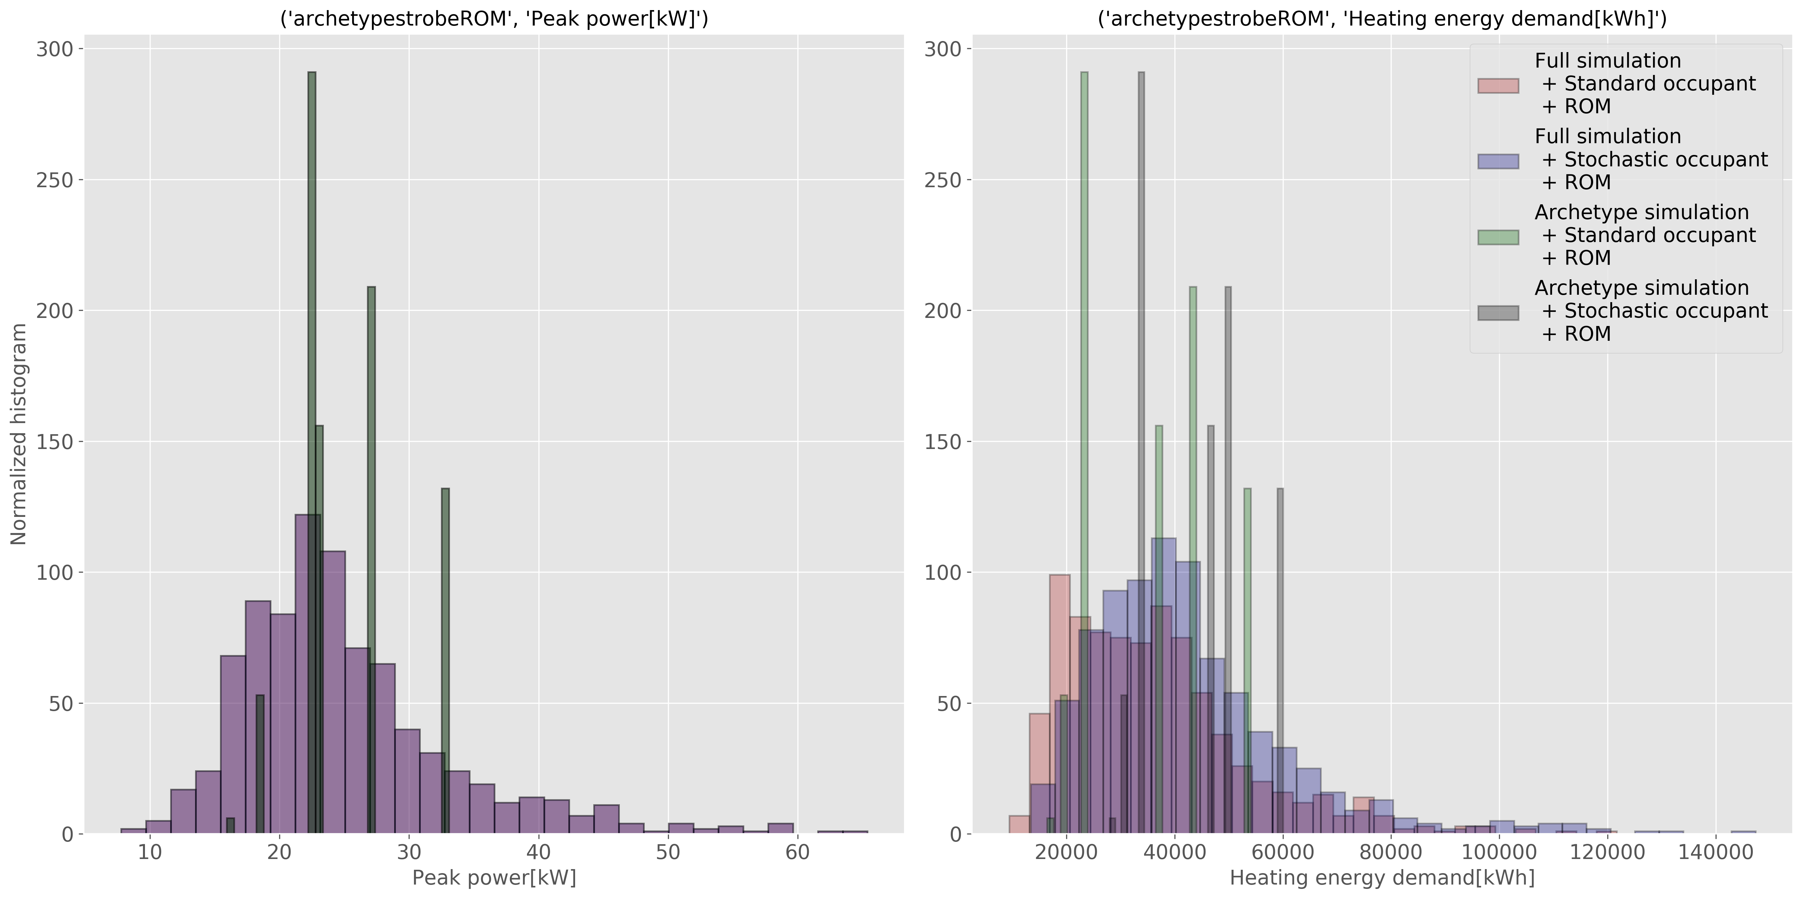
Results of full simulation<> archetype simulation

Slide 19
Conclusion
Averaging temperature set-points from StROBe leads to underestimation of heating demand
Averaging actual minimal building temperatures
Annual energy use represented well
Load duration curve has some issues
Ongoing work
Check archetype models
Compare with model including overheating
Compare with simpler set-point method

